Slide 1
RVW Model – Productivity Improvements
Aviation Product Development : Oct 2022

Slide 2
Solutioning & Requirements Workbench
Conducted a survey across the team to collect platform productivity related improvements
Prioritized specific feedback
Previews
Grid
Publish Subscribe
Overall Feedback on understanding , design, user experience of the tool

Slide 3
Topic 1 : Proto Preview
Key elements not part UI Generate Preview
State Definitions (Buttons/ MLs – Visible – Yes/No)
Templates
Icons
Tiles
Tree Grid with Data
For most important screens ( such as Hubs)
Unable to Visualize the Tile look and feel/ height
Screen Completeness/ Beautification being done without State driven controls visible properly
No Sample data for Tree Grid
Impact
Iterative solutioning change and deployment –typically only after screen is up
Results in codegen and screen preview to view every single correction
UI Reviewer cannot run through Scenarios in Proto but a static UI
For 1 week of a medium screen design ( Hub) , we do a re-work for an equal effort after design

Slide 4
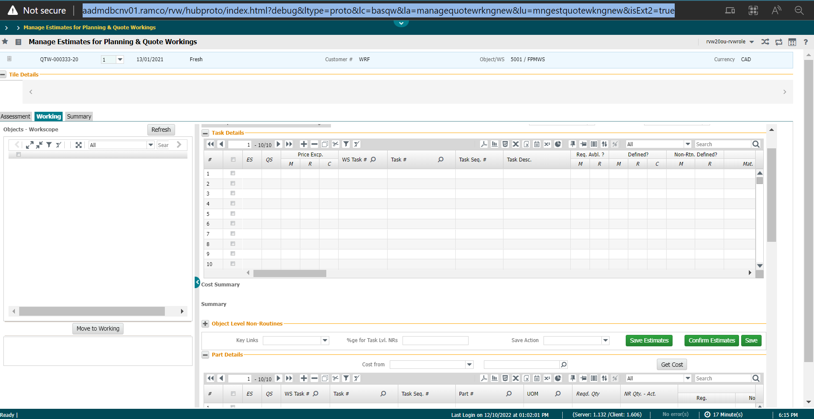
Proto Preview an example
Tiles Section missing
State for buttons
Action Icons

Slide 5
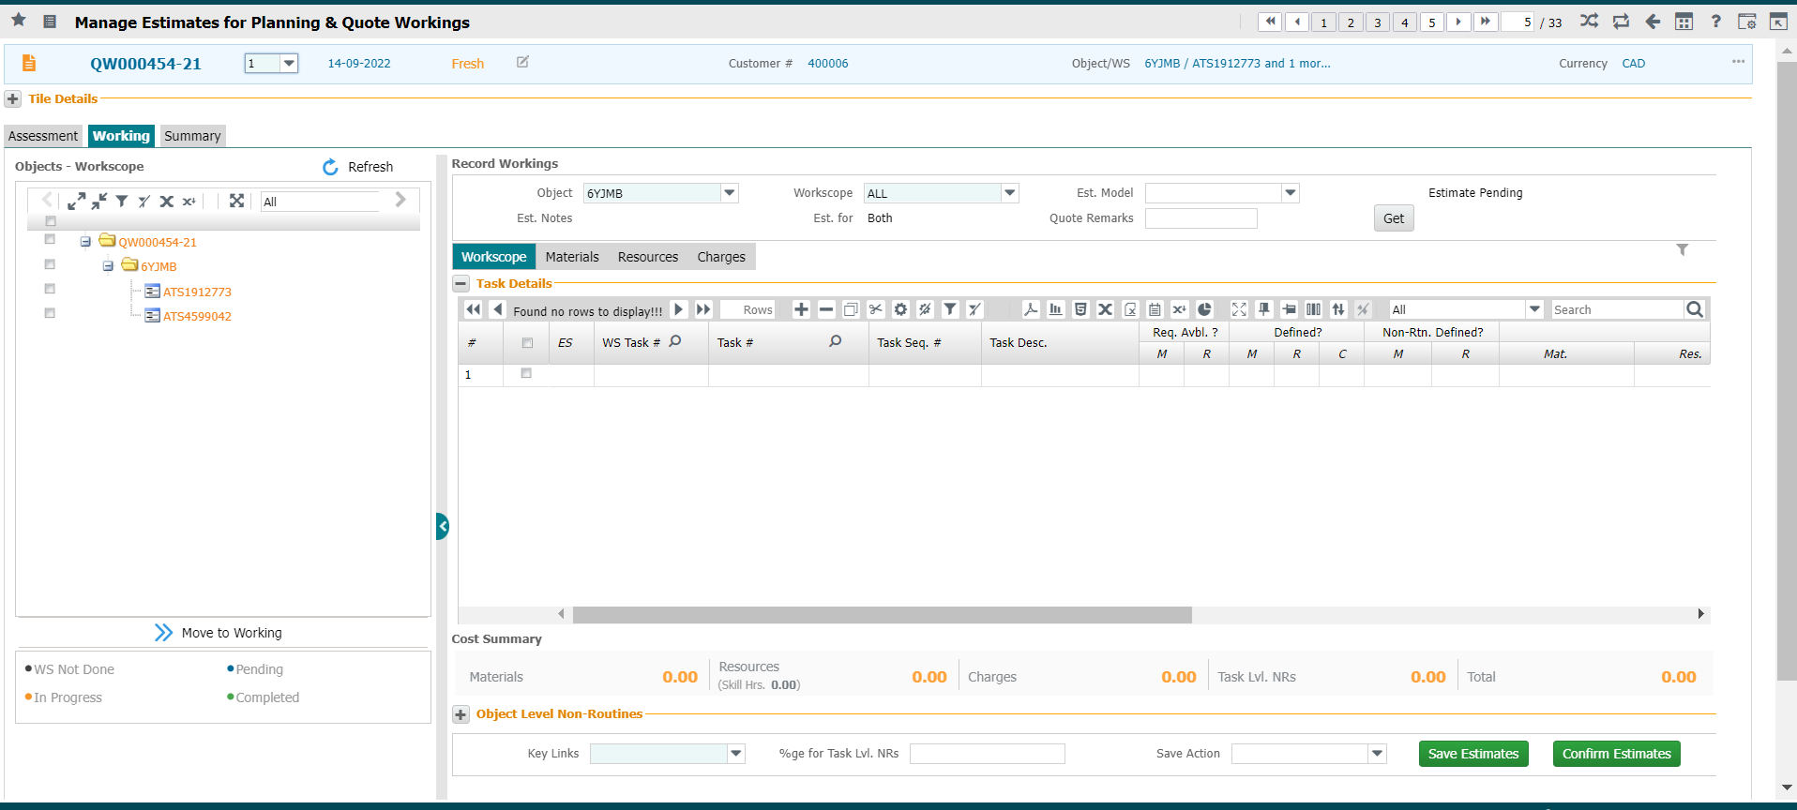
Proto Preview
Screen height only after deployment
Action Icons

Slide 6
Proto Preview
Recommended Resolution:
Option to select the State in the Preview to view the screen state
Task and Corresponding State List can be shown
A default screen state as an option to start with
State JSONs can be created at the Preview stage
Enable a provision for Sample data for a Tree Grid
Template JSONs/HTMs can be outed in the Preview to visualize

Slide 7
Proto Preview
Option to Task & State Desc. for user review
Tasks State

Slide 8
Enhancements to Grid Modelling

Slide 9
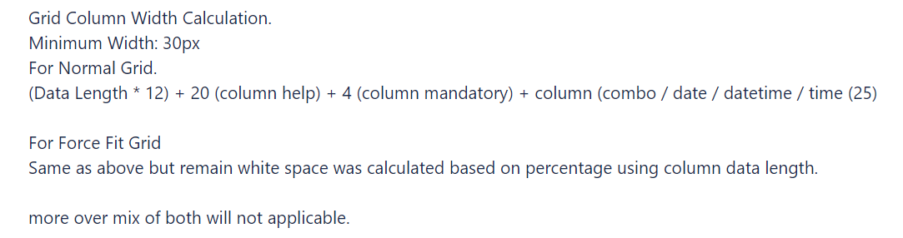
Grid Column Width Management
ML Columns
Indicator Columns - fixing the width is tiresome
A formula is provided, but nobody is able to understand, would like to have a practical session with live screens .
Trial & Error – modification of Data column width & Label Column width to fix the column width
New Column insertion in-between – Seq. # change is also tedious
Impact
Time consuming – every time generate preview. Trial and error correct
Resolution:
Provide for the easy reference guide for fixing the column widths which can be trained to all users
Previews at atomic level ( for a grid level)
Provide a method to auto re-sequence the columns for new column insertion by introducing breaks or allowing decimals

Slide 10
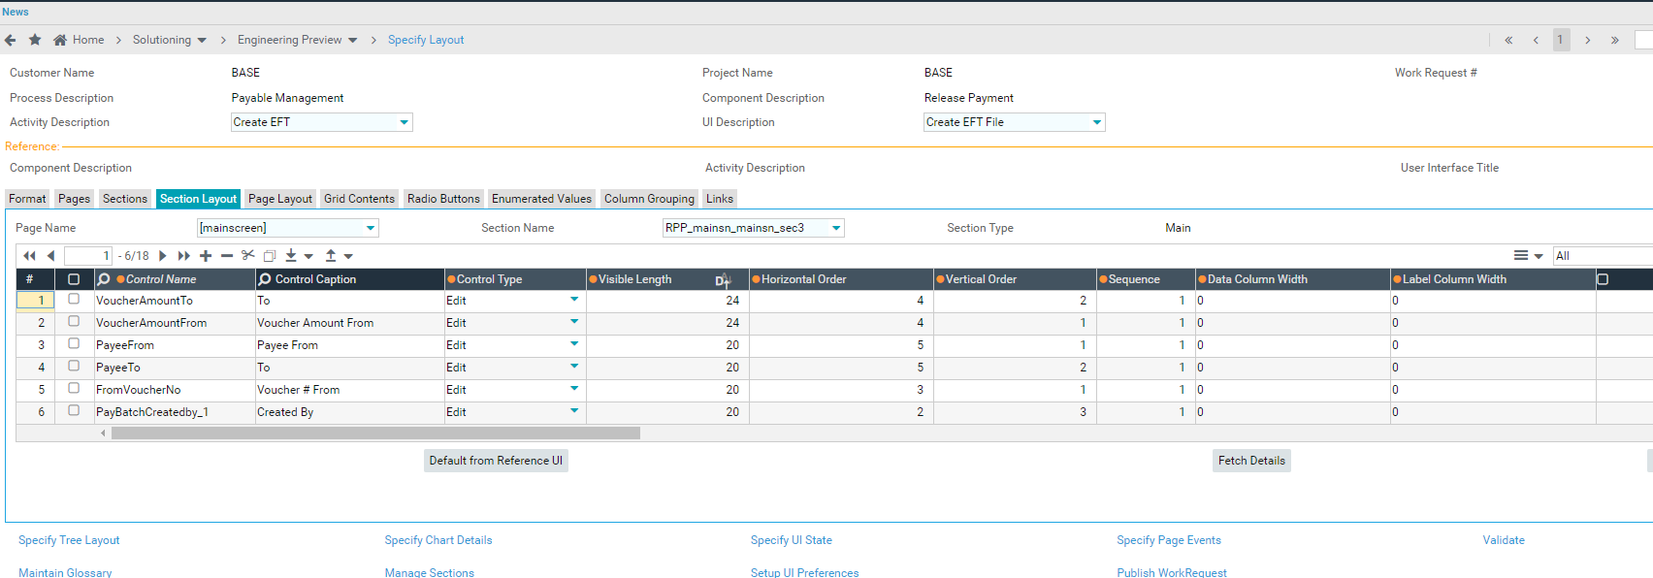
Enhancements to Grid Modelling
Currently, Identifying the appropriate width is bit time consuming involving multiple trial & errors iterations
Requirement: To Automate Column Sequencing with respect to the newly inserted column’s seq no.
Eg: To a grid with 90 columns a new column is inserted to the stack with seq no as 35. Currently, user will have to manually change the follow up seq no (36,37,..91) / Use export facility.

Slide 11
Grid Column Grouping
ML Column Grouping
Column Grouping is a separate Definition
Column Group Sequence among the column groups and non grouped columns is s part of that definition.
Many features are not available – column group freezing, background colors, export to excel*
Impact
Time consuming – every time to add a new column group/ column – Sequence updation takes time.
Resolution:
For simple grouping of a few columns, enable creation of the group in a pop-up and enable mapping in the same grid definition page
.

Slide 12
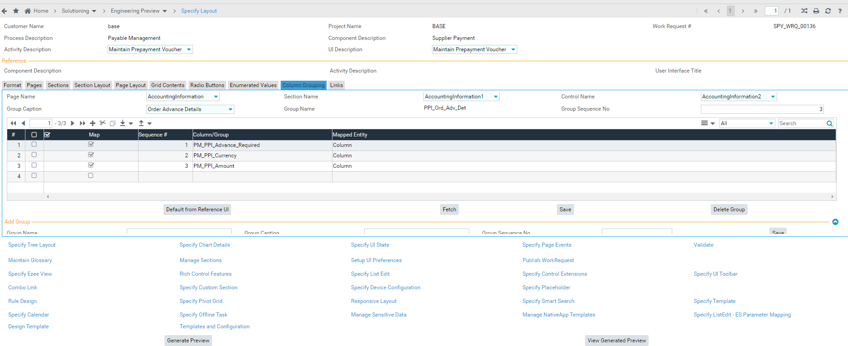
Enhancements to Grid Modelling
Enhancements in Column Grouping –
To View the defined Column Caption name in ‘Column Grouping’ tab. (Currently, Grouping of columns is done by referring to the Column control name)
Currently, For columns defined in Group, ‘Column Freezing’ property is not available.
Ability to define Background colors for column groups.
On Export ML action, the column groups defined cannot be viewed in the exported file.
Re-adding columns in Runtime is not possible. (RVW refresh / relaunch is required).
Column Grouping functionality to be moved to Grid Contents tab.

Slide 13
Enhancements to Publication Subscription screens

Slide 14
Publication & Subscription
Can we improve its efficiency
Enable Subscription and Resolution from work request in place
Perform subscriptions more efficiently
- Identify the publish link in the traversal definition ( WR)
- Default the publish link controls , enable mapping with a subscriber control
smart search
- Aid Subscriptions pending through a To-do based approach – Tree/ Hub etc
- Can we also approach this as a graphical UI
We can come up with a design for this

Slide 15
Short Close WRQ

Slide 16
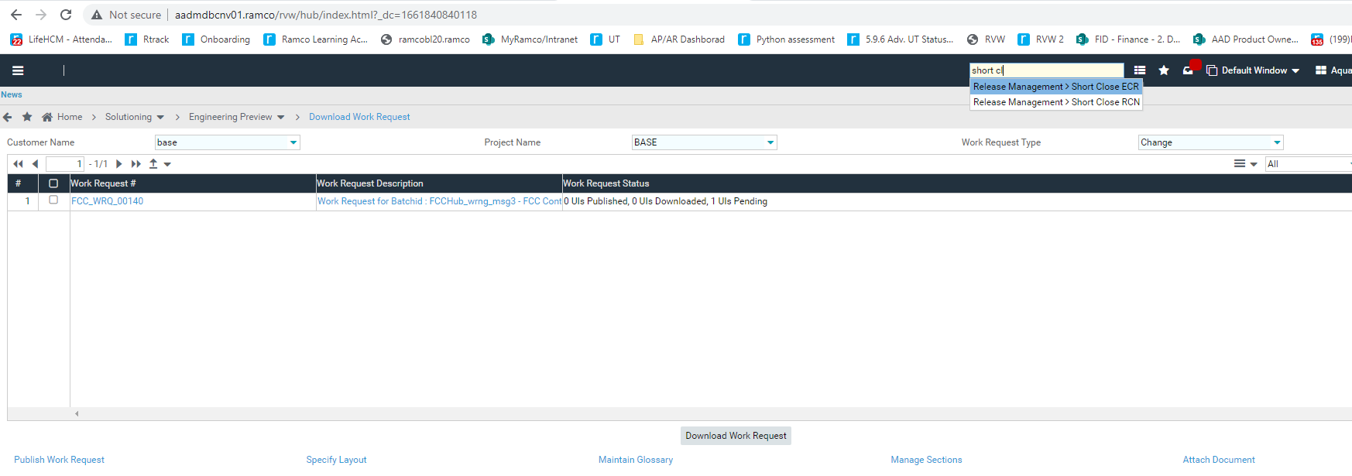
Short Close Work request
Undo a Work Request?
We start a Screen solutioning, but it may not be required and hence to be scrapped.
Manually delete all the controls/sections added.
Document deletion would be more reliable than manual process
Short close Work Request is not available in model currently

Slide 17
I Rule - Requirements
Very Clunky Screen design
Element Clarity is very low
No way to do multiple bulk definitions
Creation of new template/eval IDs don’t refresh or give an msg.
IDs cannot be deleted once created
The rule building is extremely time consuming for bigger conditions within a single edit field – would be nice to have grid view for this and the preview section can show the generated code
Having to open a pop-up everytime to setup state property for a control individually (no way to set that up for multiple controls or sections at a time)
Too many scrolls – making it uncomprehensive on where to look next
Debugging post deployment is difficult – only have to review the preview of logic to recheck if the properties are all set right.
Since only EvalID is carrying both the condition & associated property can it not be directly mapped to task instead of using Template/Group (Difference between template & Group is unclear)
i-Rule can be setup & accessed only on extui version of rvw.

Slide 18
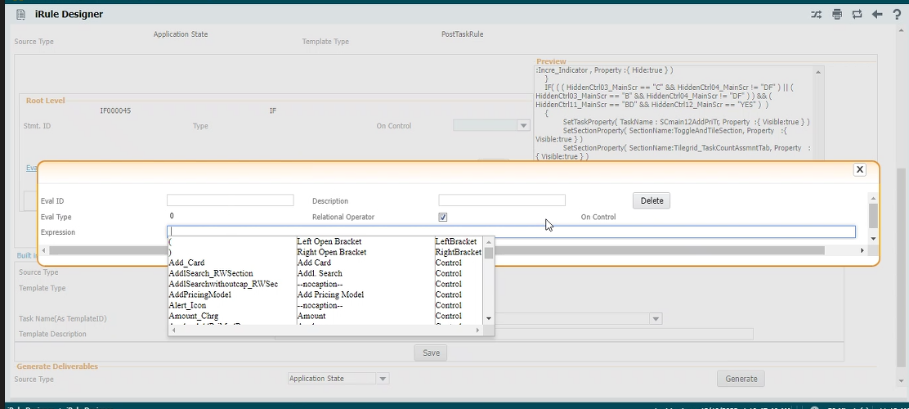
Usability – Multiple Pop-ups and multiple screens & save with Scrolls

Slide 19
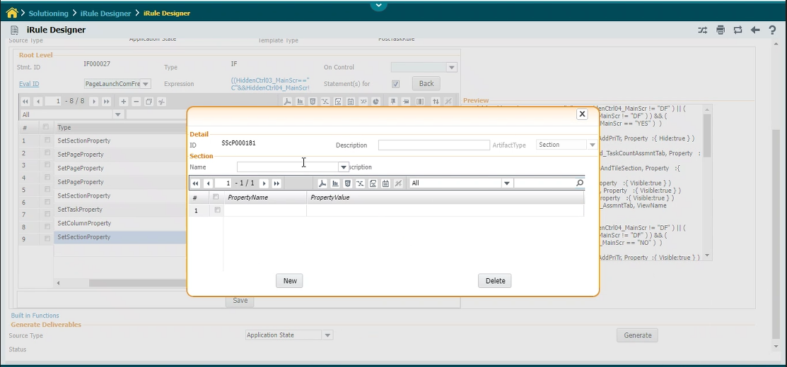
One by one definition for each control type

Slide 20
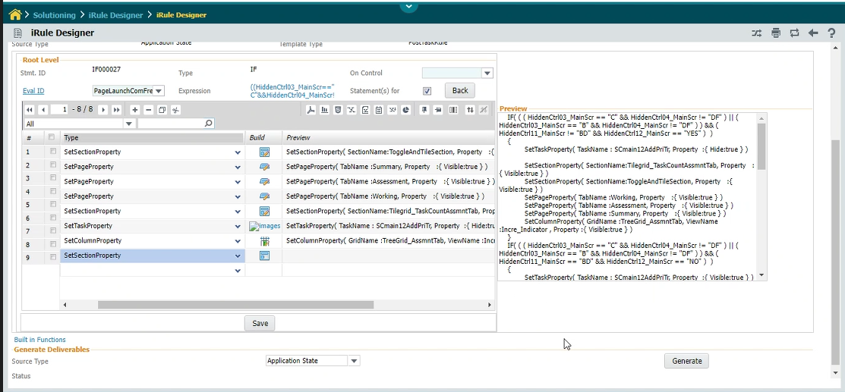
XML Preview is not readable to review the Definition

Slide 21
General Feedback
Diminishing Clarity
Information Hierarchy Organization (Mix up of Tabs / Links / pop-ups)
Control Types, Behaviour
New Feature Positioning:
Irrelevant activity, control, option cleanup , sequence
Archaic Designs
Implementation of modern design approaches ? - Hub/ Tree/ State/ Smart Search
This could have served as a good reference for design if used
No documentation : Online Help & Reference manuals not maintained
Training is very basic , there are experts in some areas on some features
Overall, does not inspire one to generate and maintain a high quality design and sets new comers on a low performance bar
Since over 90% of the effort is in maintaining the existing UI’s , would be extremely beneficial if the workbench can be re-designed to support the above
Migration to Glance did not work and would not be an option for us

Slide 23
I Rule
Usability – Multiple Pop-ups and multiple screens & save
Template ID – Post Task Rule @ task level creation does not give success message – Unable to Delete/ no info about whether we have defined the IF condition or not
Template ID & Eval ID cannot deleted at all (junk eval IDs cannot deleted)
XML preview – readability is not there (no indent etc.,)

Slide 24
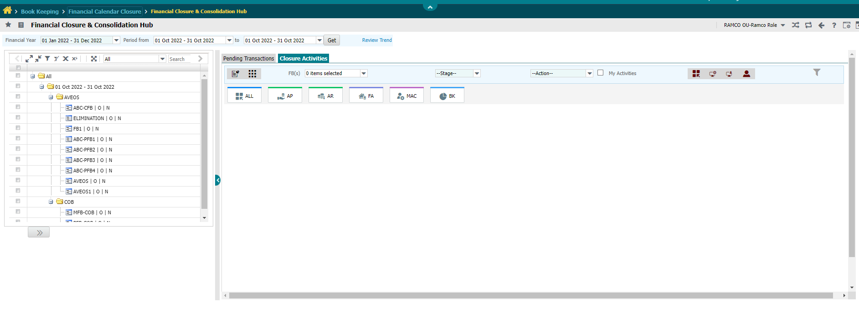
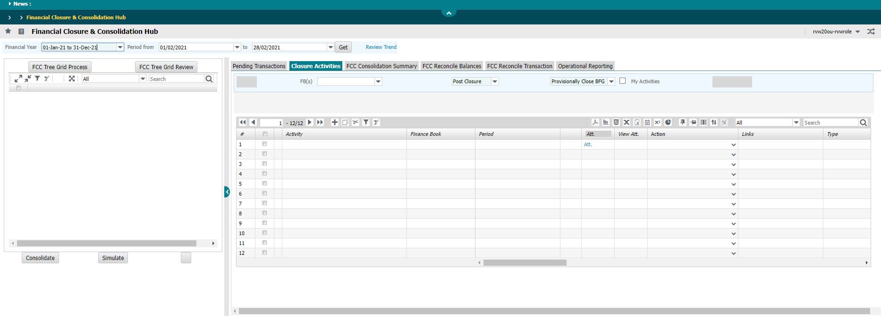
Product vs Preview (Icons, Templates, Tiles & Tree)
Tiles Section
Action Icons
-> PRODUCT
-> PRODUCT
-> PRODUCT
Tree Hierarchy
Requirement: To Enable provisions to view Icons, Tiles, Templates and Sample data for tree in the preview screen of RVW.
RVW PREVIEW ->
No sample data (tree grid)
State Controls Visible
Template Definition

Slide 25
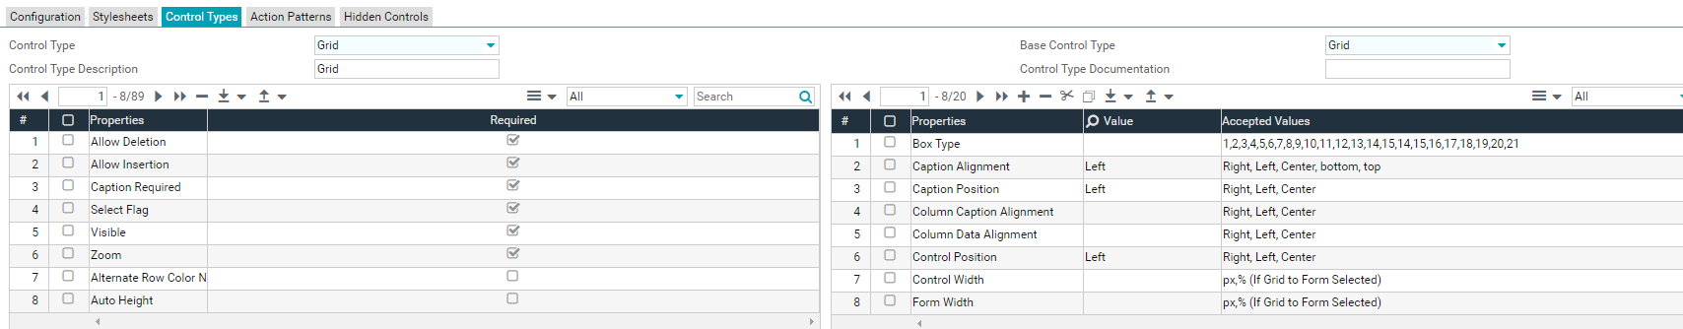
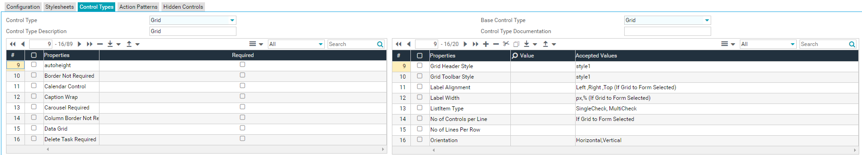
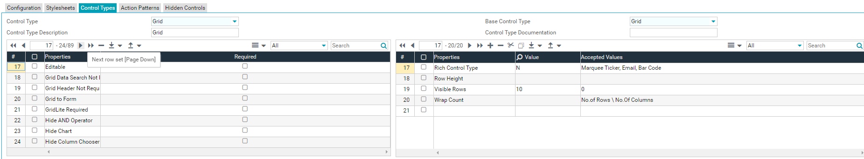
Control type properties

